Slide 1
Task 1: Team management and process
Things to discuss:
What roles does your team have?
What jobs has your team planned for who, how often have you met already?
How regularly will your team meet and why did you choose this interval?
How does your team collect meeting notes, ...?

Slide 2
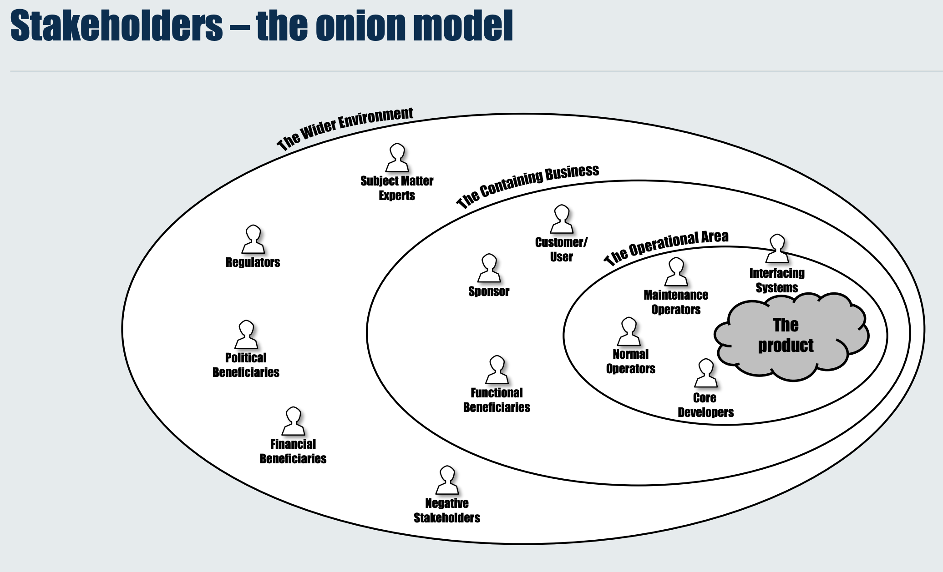
Task 2: Identify a list of relevant stakeholders

Slide 3
Some examples
British Fashion Council (Regulatory)
Employees and customers (User/Customer)
Manager (Sponsor)
Online-sales team
Union (Possibly negative stakeholder)

Slide 4
Task 3: Identify functional & non-functional requirements
Two frameworks:
MoSCoW
SMART
Must have
Should have
Could have
Won’t have
Specific – target a specific area for improvement.
Measurable – quantify or at least suggest an indicator of progress.
Assignable – specify who will do it.
Realistic – state what results can realistically be achieved, given available resources.
Time-related – specify when the result(s) can be achieved.

Slide 5
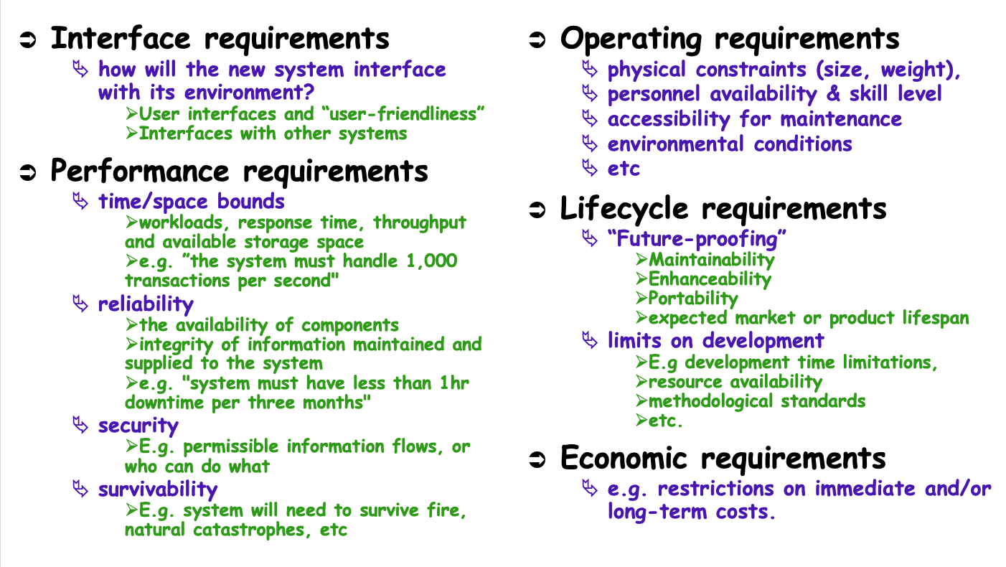
Example NFRs

